Slide 1
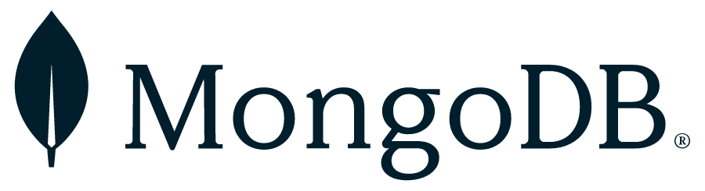
MongoDB documentation:
MongoDB Manual v8.0

Slide 2
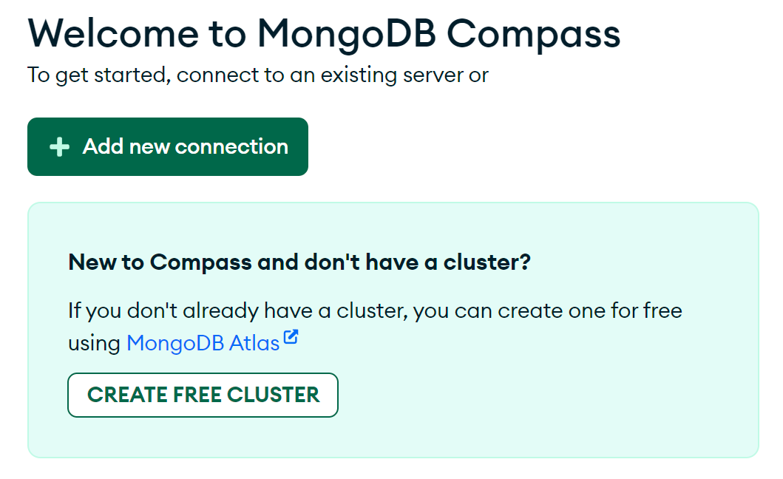

Visit the MongoDB community edition install page , and install the appropriate version for your computer.
During the setup process, it will ask you if you want MongoDB compass, so opt to install MongoDB Compass (on non-windows you may have to install it separately).
Launch MongoDB Compass, and follow the “create free cluster” link to create a new connection through Atlas (MongoDBs cloud version – you get 512MB use for free).

Slide 3
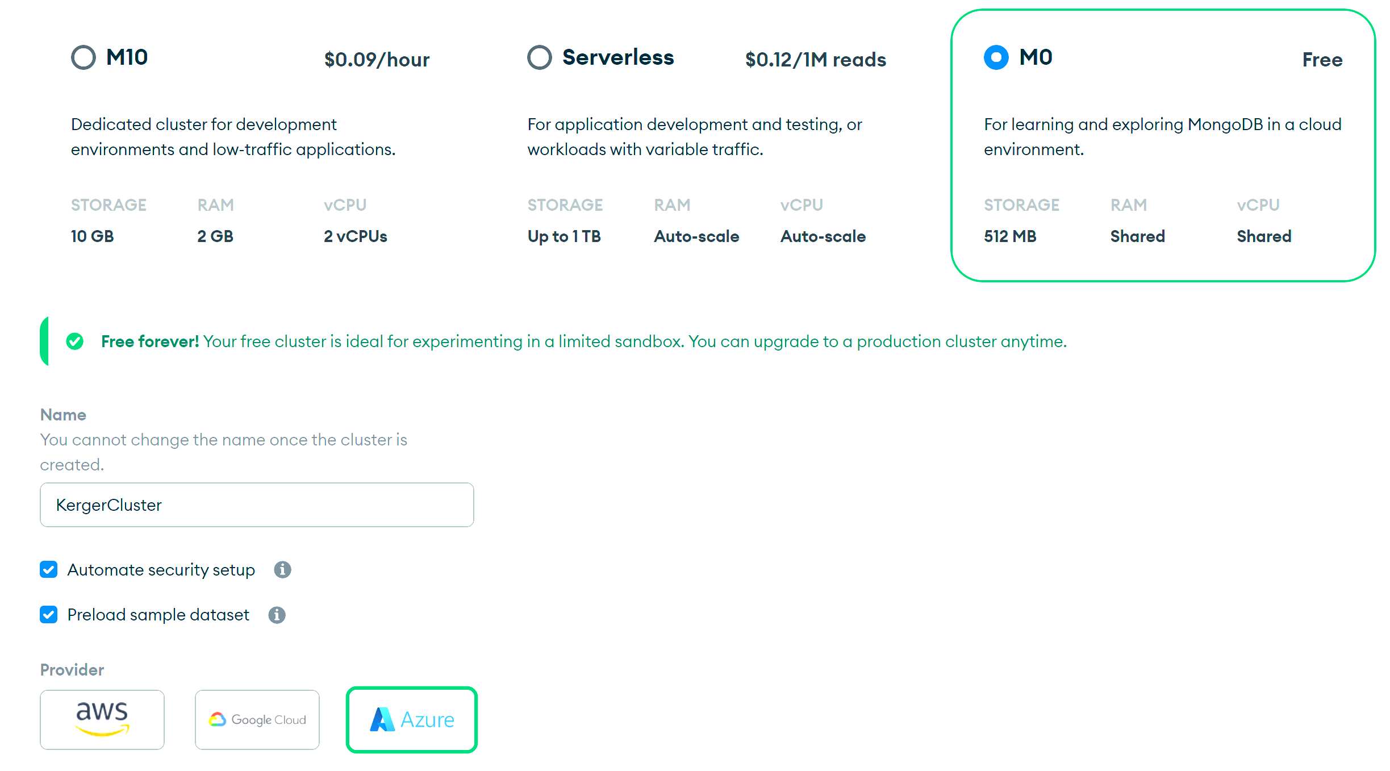
Select M0 free tier, along with cloud provider of your choice (AWS, Google Cloud, Azure).

Slide 4
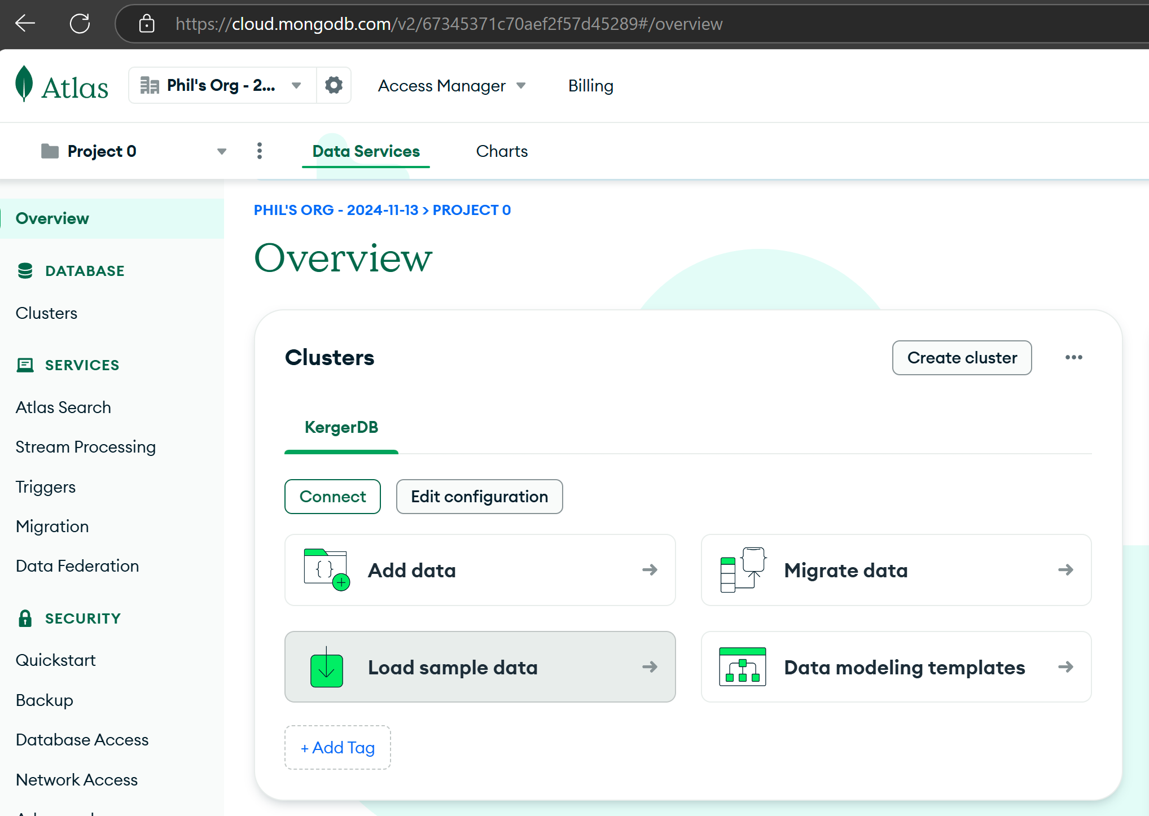
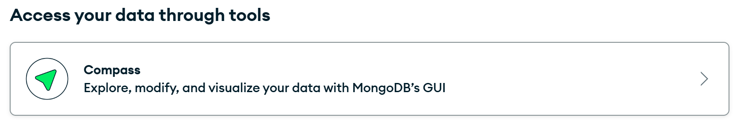


Slide 5
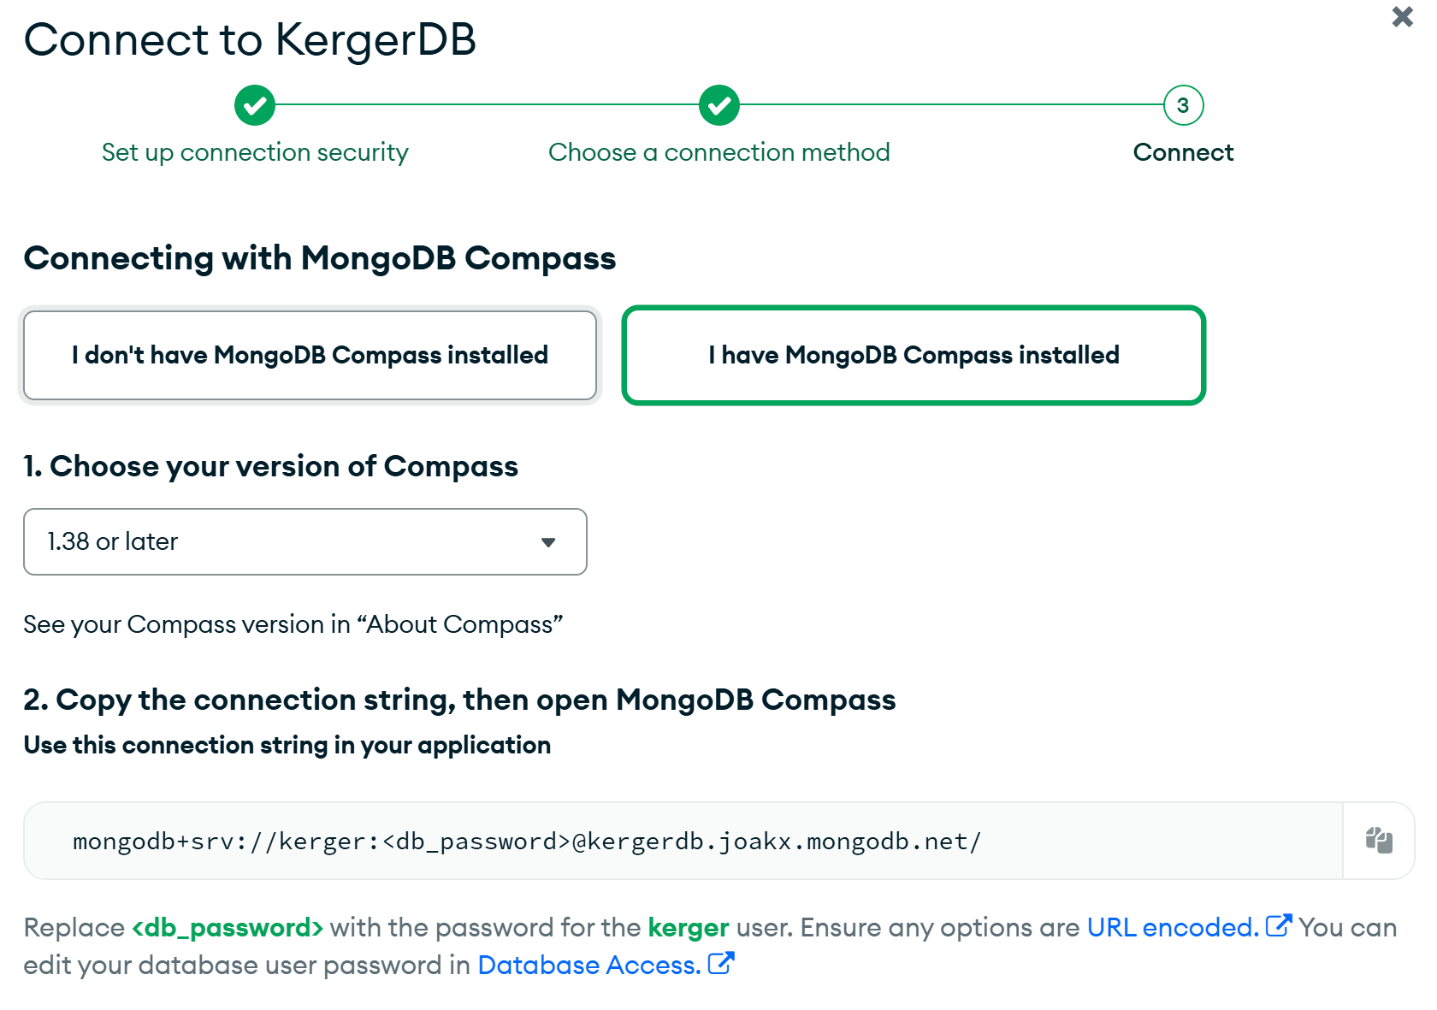

Connect to your DB by using the connection string from Atlas in MongoDB Compass

Slide 6
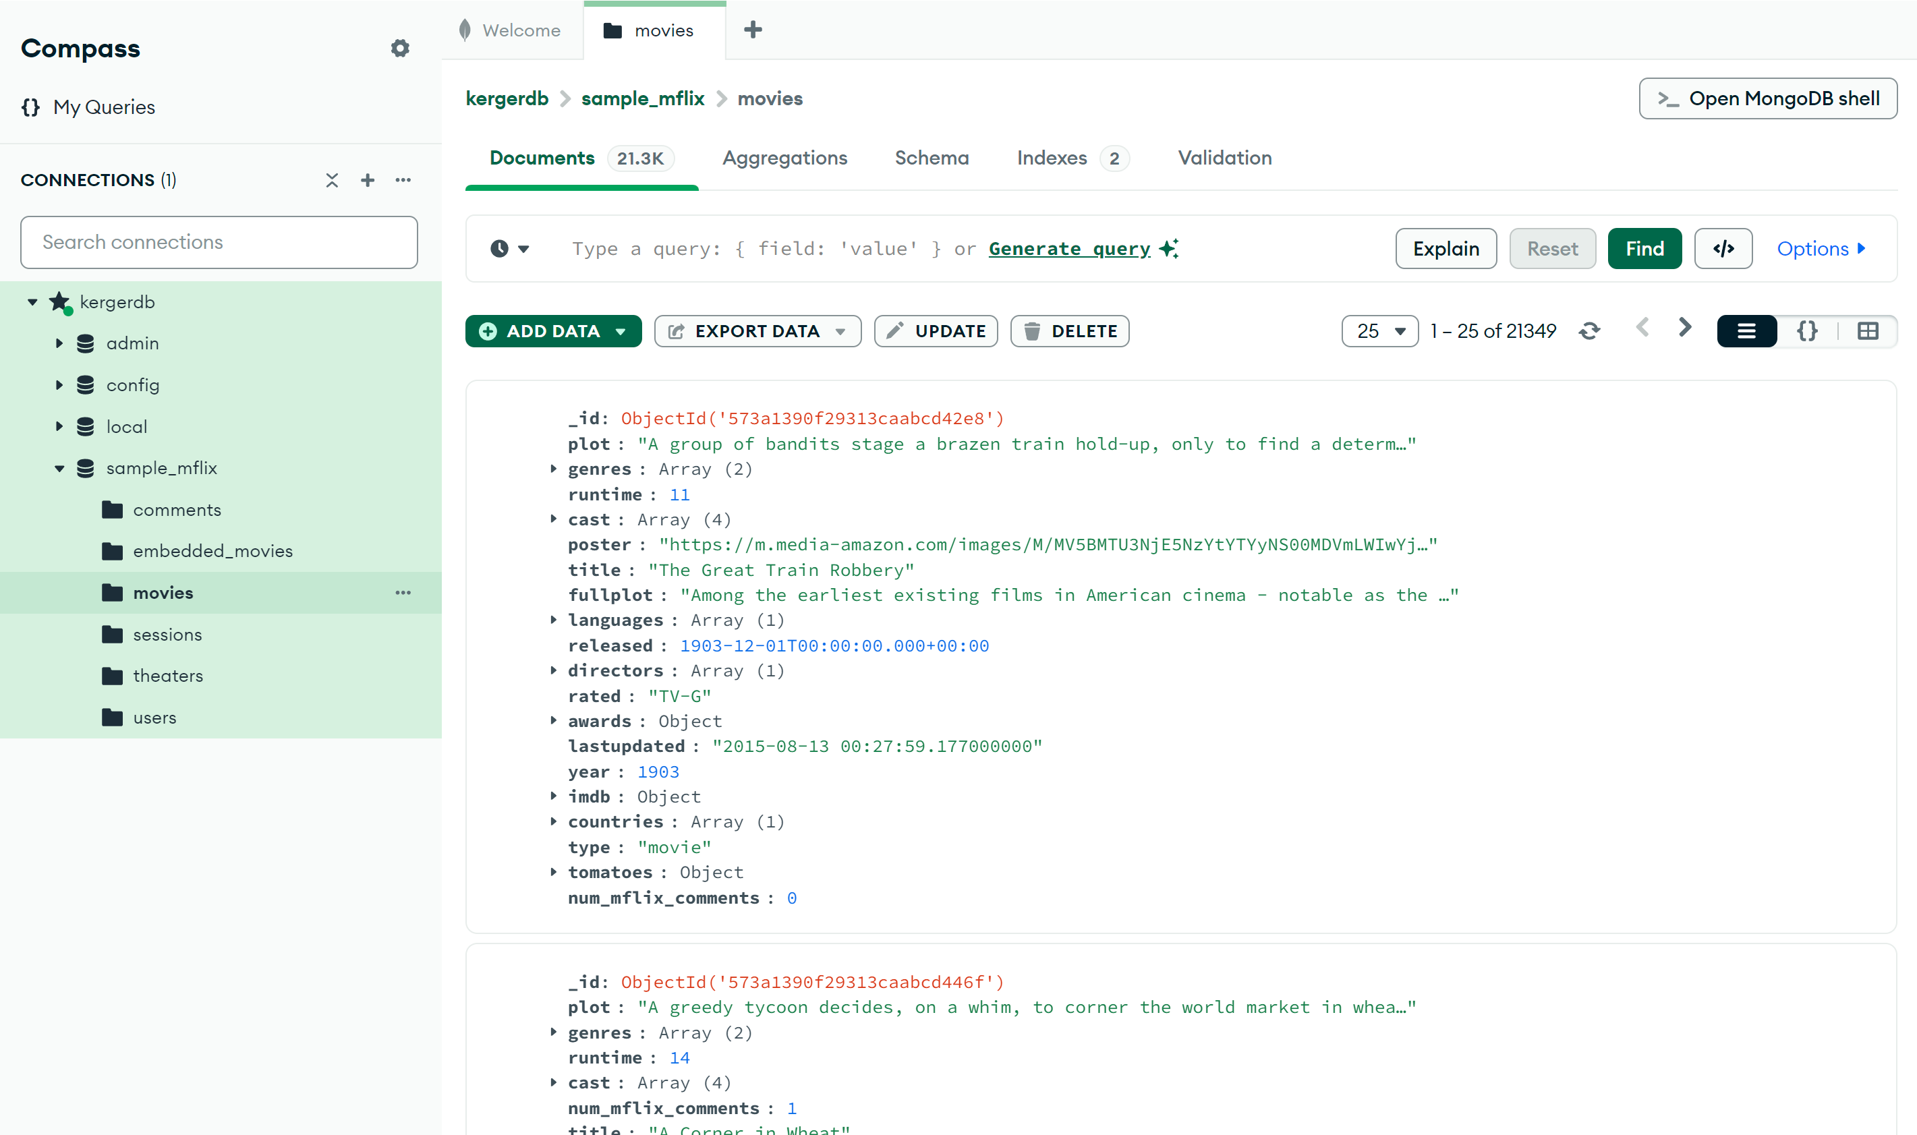
Now you are connected to your new cluster;
There will be some sample data, and you will be able to implement your own databases there now.
Note: You can have one cloud DB per team this way since it is hosted in the cloud with Atlas. One person can create the DB and then create user accounts for the other members, as one would do in a company.

